Slide 1
The power of choice
Build an A-team which embraces choice and consequence conversations

Slide 2
Flow of the session
The importance of a creative mind-set
Creating teams of A-Players
Being kind not nice
The art of tricky conversations
Managing choices and consequences
A-player acknowledgement

Slide 3
YOU!
INTRODUCING

Slide 4
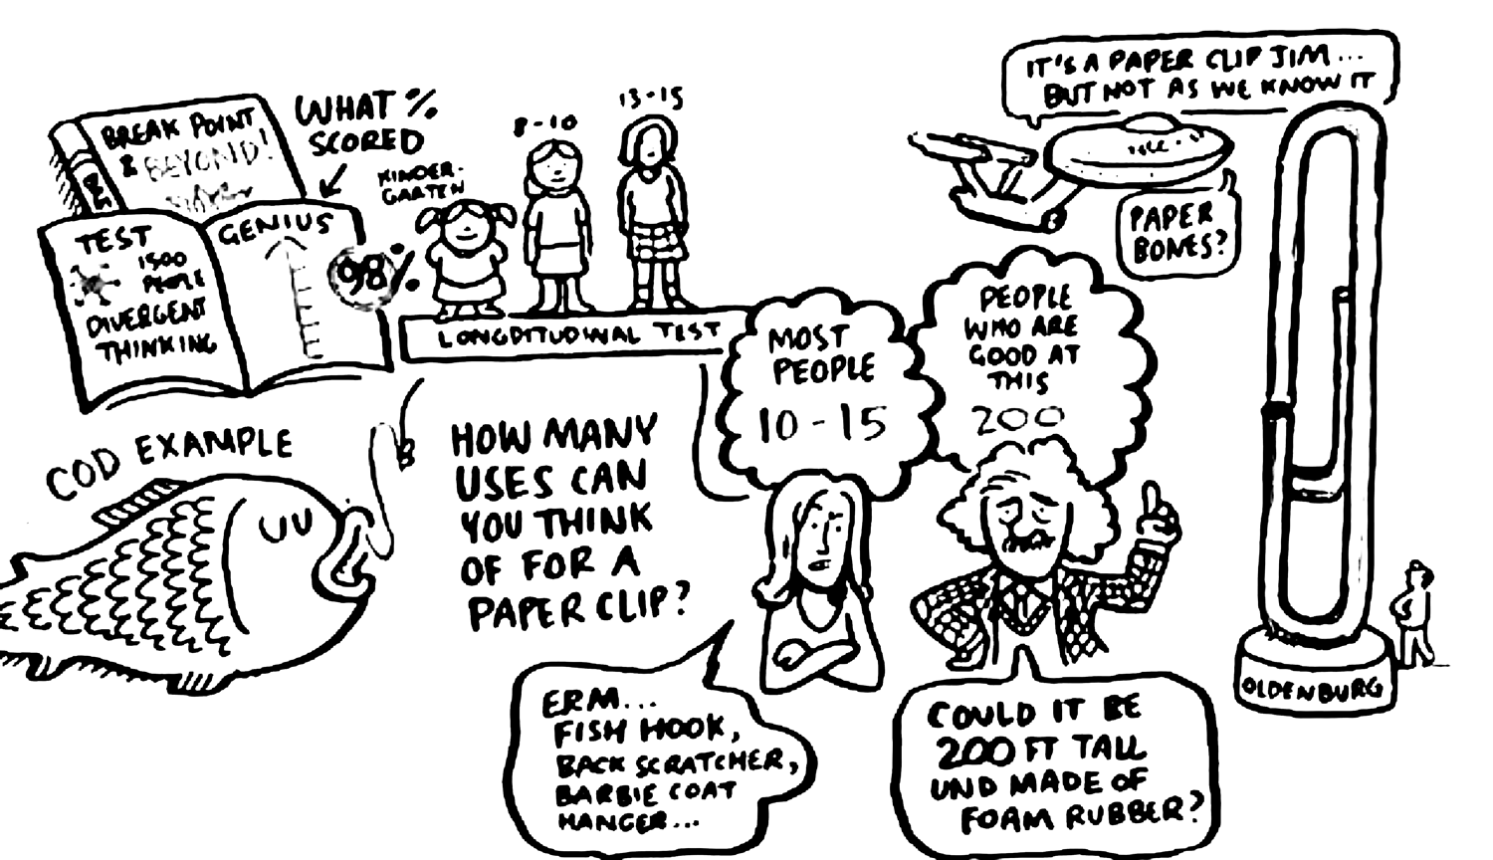
The Paperclip study
George Land and Beth Jarman

Slide 5
Creativity & Innovation

Slide 6
accelerator manifesto

Slide 7
CREATING A TEAM OF a-players

Slide 8
Identifying Sony MUSIC a-players
In small groups:
What does A-Player behaviour look like at Sony Music?
Which behaviours are valued and create the best team and business results?
What does C-Player behaviour look like at Sony Music?
Which behaviours cause challenges and detract from business success?
Share back the top three A-Player and top three C-Player behaviours to the group.

Slide 9
BEING NICE
BEING KIND
Avoiding conflict and pretending all is well regardless of the situation
Giving people a message they need to hear and acting in their best interest

Slide 10
Nice versus Kind
In small groups identify a performance management scenario which might occur at Sony.
Capture on a flip chart:
The feedback you would give if you were being ‘Nice’ .
The feedback you would give if you were being ‘Kind’ .
Share back your scenario and the nice vs kind feedback to the group.

Slide 11
Tough love – your role as a MANAGER & coach
Clear Expectations
Ensure everyone understands what performance levels are required so any performance shortfall is not a surprise.
Swift Action
Never wait too long to address performance issues.
Change Champion
Your goal is to achieve a 100% mutually beneficial outcome.
Sell the Benefits
Always explain the long term benefits, even if that means short term pain.

Slide 12
Mirror mirror
Answer the following questions thinking about a person you need to have a tricky conversation with …
FROM YOUR PERSPECTIVE
FROM THEIR PERSPECTIVE
1 What do you consider the performance issue to be?
2 What implication or impact does the performance issue have for you and the wider team?
3 How have you contributed to the current performance issue?
4 What have your intentions been?
5 What does success look like for you?
1 What do you consider the performance issue to be?
2 What implication or impact does the performance issue have for you and the wider team?
3 How have you contributed to the current performance issue?
4 What have your intentions been?
5 What does success look like for you?

Slide 13
IDEAS to tackle tricky conversations
IDENTIFY the performance issue plus any data or examples
eNGAGE to really understand their perspective and explain yours
DESCRIBE the impact it is having on their ability to be truly successful and on others to be successful
AGREE ACTIONS together on how you can be 100% successful moving forward

Slide 14
Practice makes perfect
Preparing for your tricky conversation
Use the IDEA model to prepare your tricky conversation.
Refer to your ‘mirror mirror’ notes to ensure the conversation is objective and offers mutual benefit.
Once prepared, get into pairs and brief each other on your tricky conversation context.
Practice having your ‘tricky conversation’ with each other.
Give each other feedback and insights.
Notes:
Context
All of us have a list of things in our head we would
like to do. Few of us but the most organised get things
done without a plan and a deadline. Setting goals makes
things happen for ourselves and others and the better
the goal the better the outcome. I recently took up
cycling and the only thing that got me started was I go
a place in a 100 mile race. Before that I had talked
about cycling but not even bought a bike!
When setting objectives not only do we think about what
we want to achieve but how we want to achieve it. Our
behaviours as well as actions may need to change. I had
to be fit enough to ride 100 miles but I needed to
commit to a training schedule and be determined enough
to get up at 6.30 to do the miles.

Slide 15
MANAGING CONSEQUENCES AND CHOICES
Your role is to GIVE EVERYONE THE BEST OPPORtUNITY TO BE AN A-PLAYER.
YOUR ROLE IS ALSO TO DISTINGUISH WHERE BEST THEY CAN BECOME AN A-PLAYER.

Slide 16
a-player acknowledgement

Slide 17
Complete YOUR SONY MUSIC GIFT OF gratitude
1 SONY MUSIC GIFT OF Gratitude
Who will you give your gratitude gift to?
Why do they deserve your gratitude gift?
What behaviours have they shown?
How did they make you feel as a result?

Slide 18
Thank you!

Slide 19
BREAK Time
Notes:
Time for a break (10 mins)

