Slide 1
(re)-Discovering your BRILLIANT SELF
Be the best version of yourself EVERYDAY

Slide 2
Flow of the session
What is brilliance?
Finding your fantastic self
The power of a positive mindset
Be more Batman
Eat frogs to get to the princes

Slide 3
accelerator manifesto

Slide 4
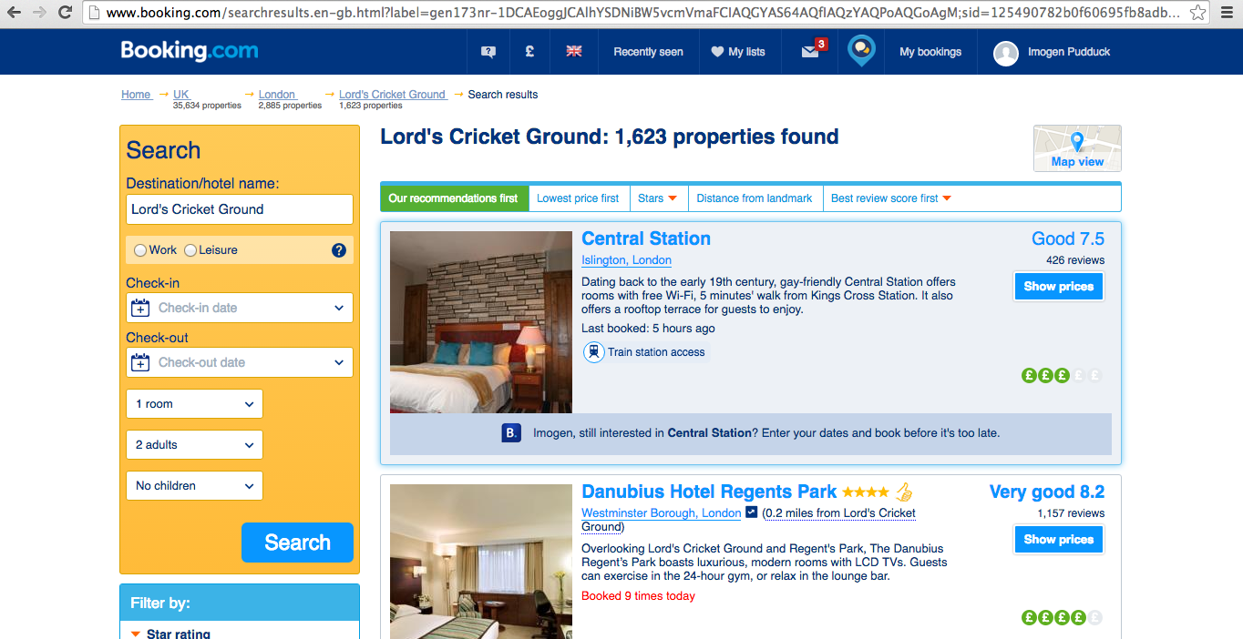
IS BEING GOOD, GOOD ENOUGH?
1. Exceptional
2. Superb
3. Fabulous
4. Very good
5. Good
6. Pleasant
7. Okay
8. Passable

Slide 5
LET’S SPEED DATE
What does brilliance mean to you?
What would you like to be more successful or brilliant at?
What helps or limits you to be brilliant?
What can you do to be more brilliant?

Slide 6
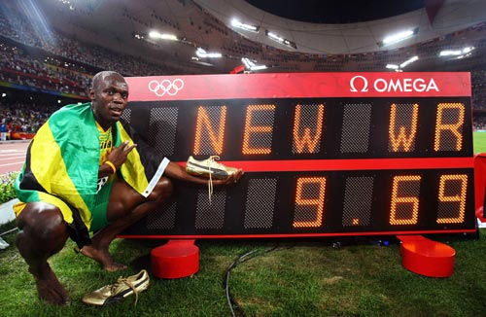
Who Remembers this

Slide 7
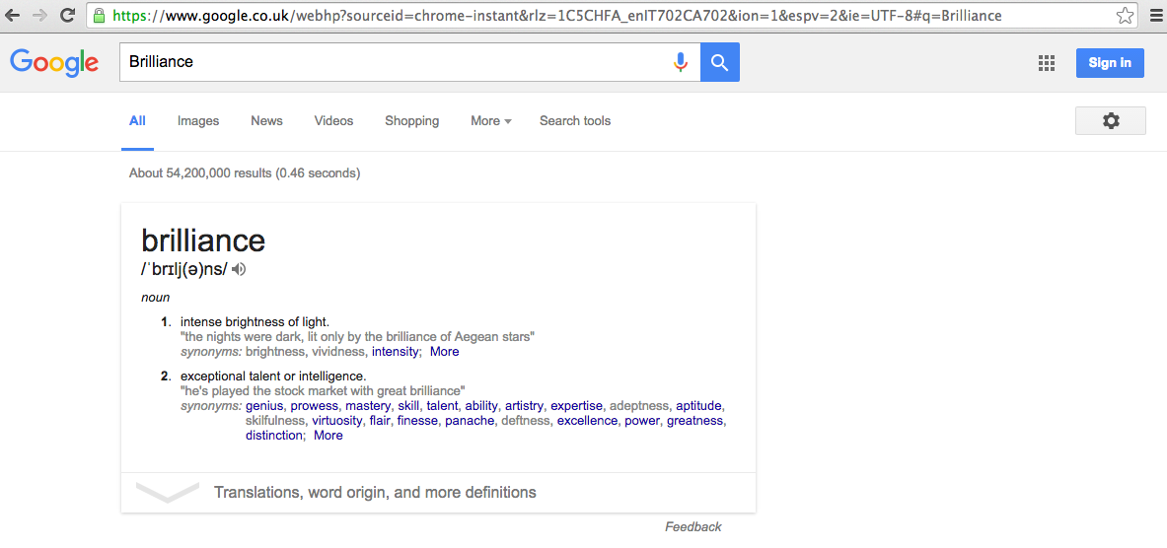

Slide 8
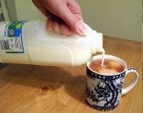
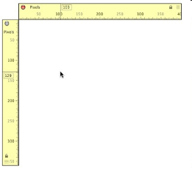
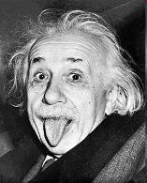
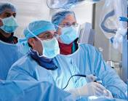
What is brilliance?
IT’S PERSONAL
IT’S IMMEASURABLE
IT’S MAGIC
IT’S INTANGIBLE

Slide 9
How will we know if we are brilliant
INSPIRATION
These can be taught, bought and measured
INTELLIGENCE
BRILLIANCE
SELF-
EXPRESSION

Slide 10
Your lifetime achievement speech
In pairs, write a speech that your team would give you in the future when you win your lifetime achievement award:
Think about all the things you’d like people to say about you…
What is the legacy you are leaving?
How did you behave? What were the values you stood by (even when times were tough)?
What made you the success you are?
What do you wish you did less of?
How does hearing your amazing future make you feel?

Slide 11
Inspired brilliance
Think of someone you feel is really brilliant:
It can be someone famous or someone only you know. It can be someone inside our outside of work.
What effect do they have on others?

Slide 12
Common traits of brilliant people
Passionate
Creative
Delight people
Performers
Alive inside
Always learning
Have fun

Slide 13
Are you being your brilliant self?
Be you
Positivity is infectious
Fortune favours the brave
Treat every day as a school day
You can be creative
Be more Batman
Breathe

Slide 14
Look at stress in a different way…
Think of a time you completed or achieved something you felt really proud of, or you surprised yourself with:
What were the circumstances and why did you perform so well?
Note down key words on post it notes.
EUSTRESS
STRESS THAT IS DEEMED HEALTHFUL OR GIVING THE FEELING OF FULFILMENT

Slide 15
SURPRISE & DELIGHT
Grab a partner and go for a wander and a ponder.
Share your examples of great customer service, or when someone did something brilliant that effected you:
How did it make you feel?
What were the key elements that made it memorable?
What could you do to pass this feeling onto someone else and exceed their expectations?

Slide 16
They may forget what you said – but they will never forget how you made them feel
Carl w. buehner

Slide 17
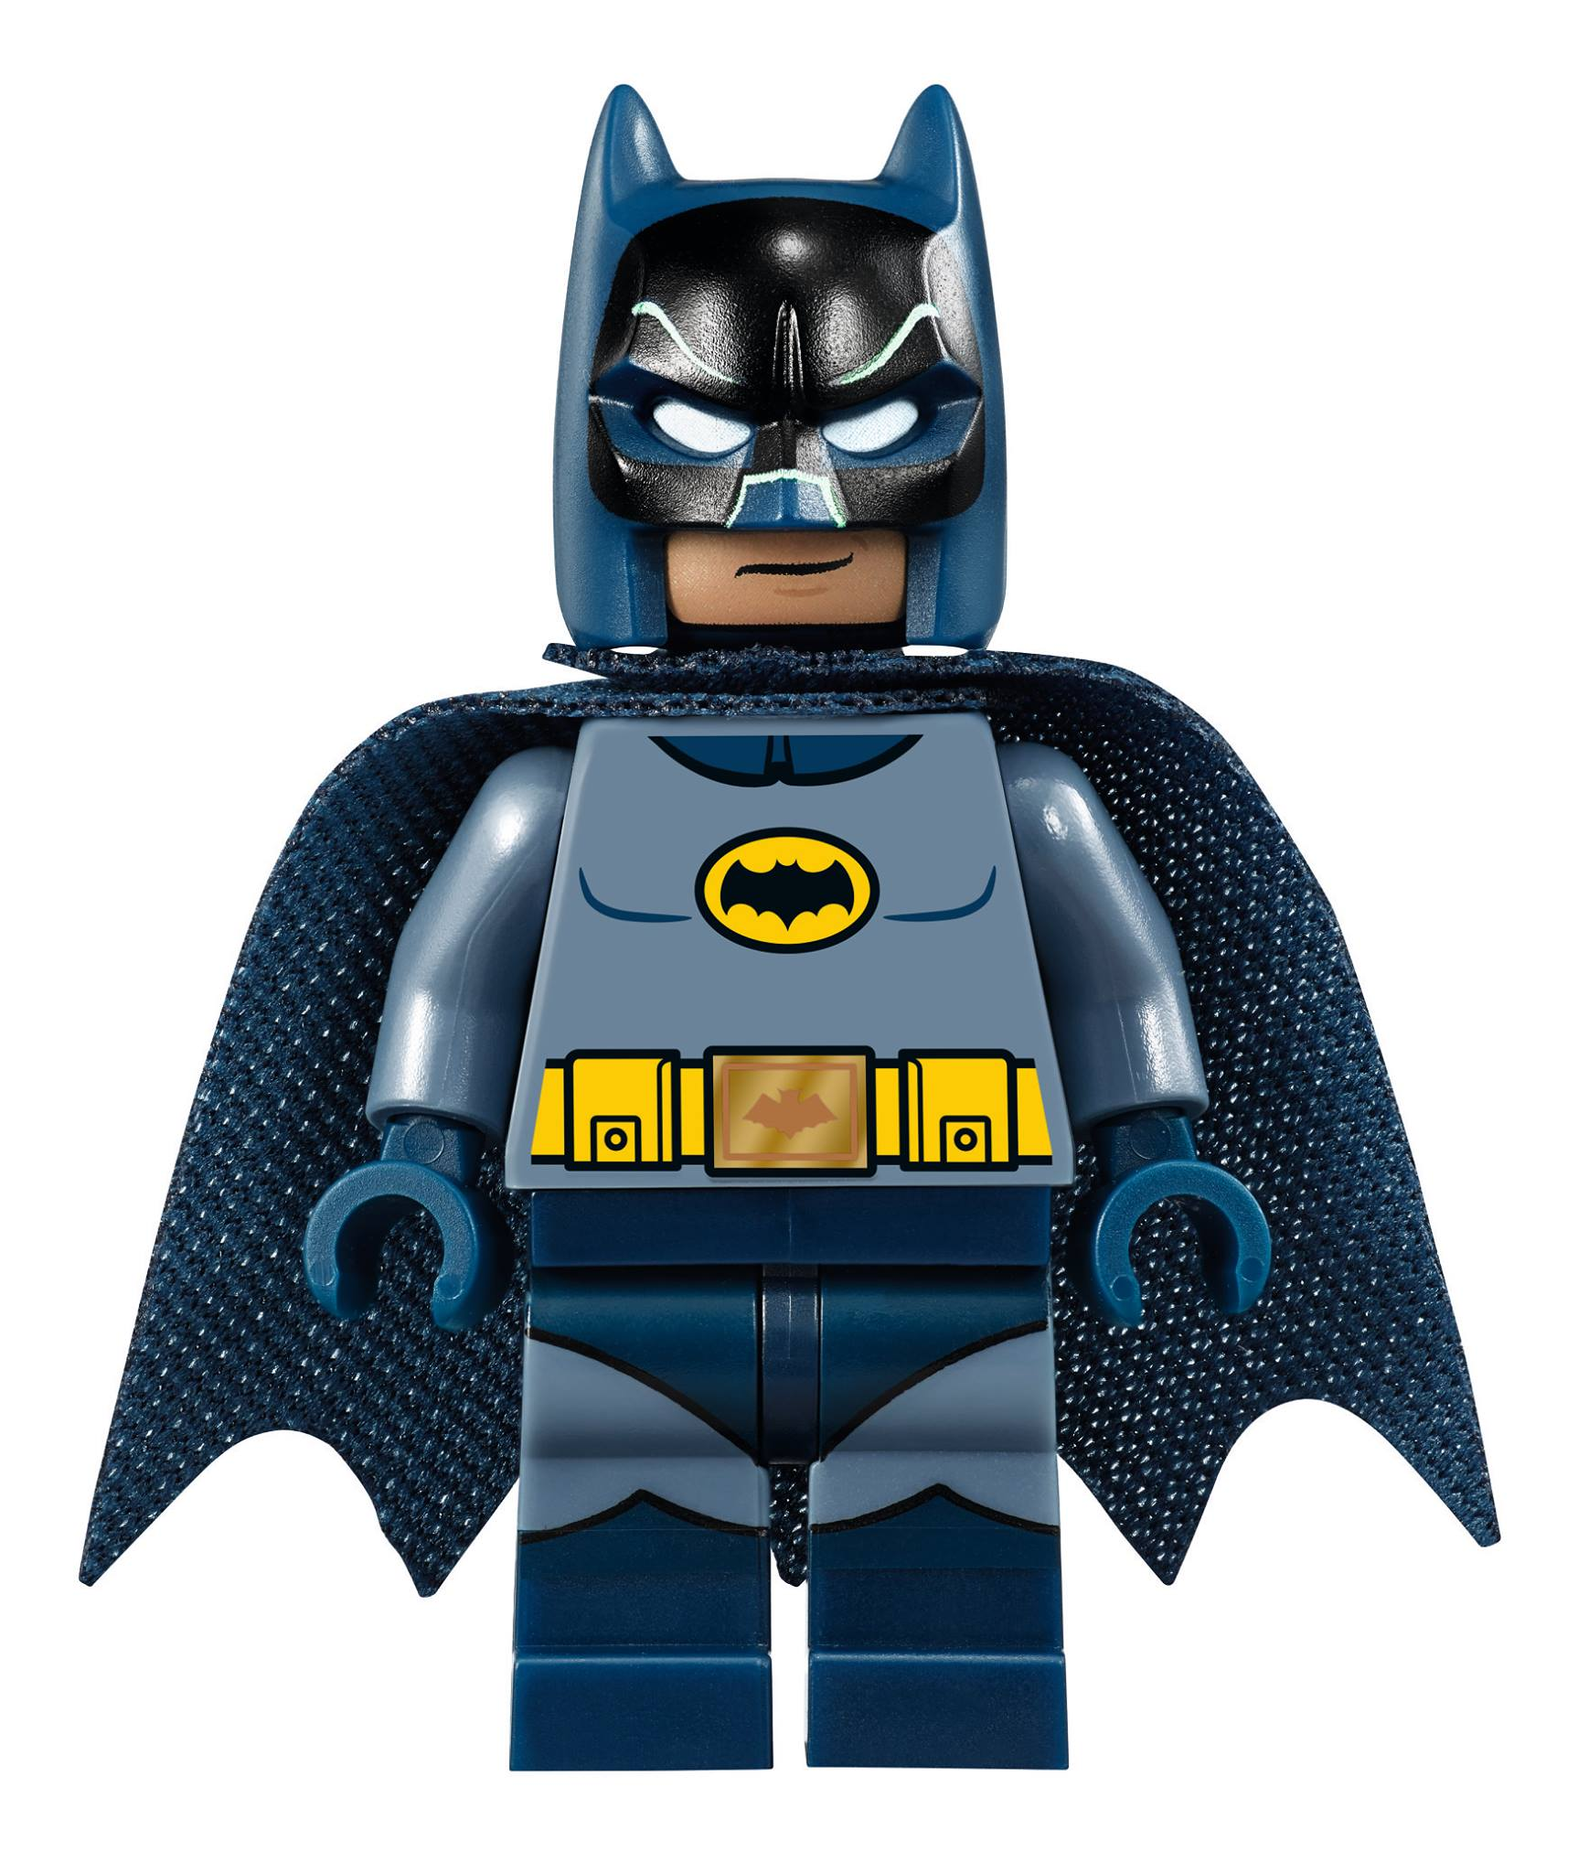
Be more batman

Slide 18
Watching feel good flicks…
Write down in your Journal:
3 successful moments from your past.
3 happy moments from your past – really good memories.
A personal list of at least 10 things you are grateful for in your life.

Slide 19
1. Begin the day with affirmations – list the 10 things you have in your life that you are grateful for. 2. Savour the ordinary – give yourself permission to slow down and experience small moments. Remember to pause once in a while. 3. End the day on a positive note – recall 3 moments of the day you appreciated instead of focusing on what went wrong. 4. Remember your overall goals – don’t sweat the small stuff.
Boost your mind state…

Slide 20
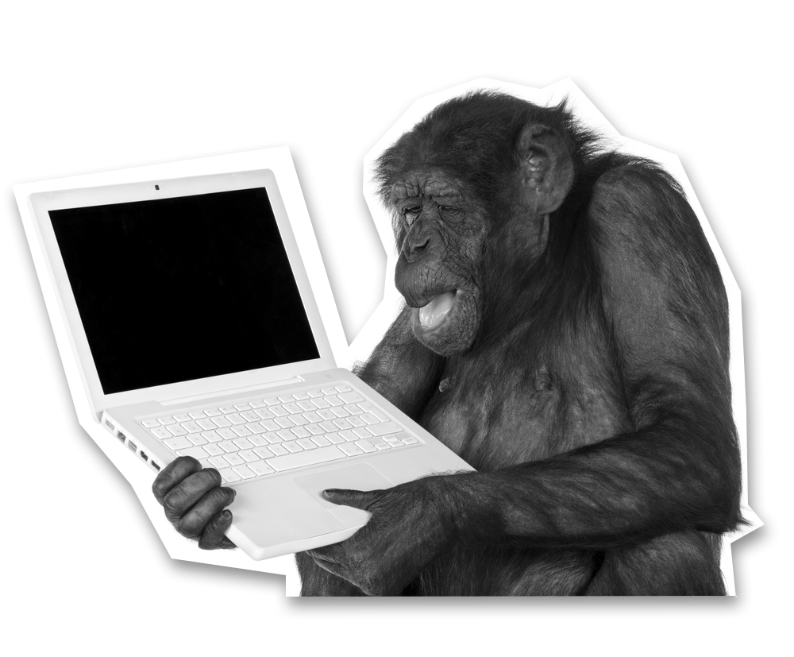
Empowered or reactive?
ANGRY
BLAME OTHERS
IGNORE IT
RUN AWAY
PROCESS IT
OWN IT
PROBLEM SOLVE
OFFER SOLUTIONS

Slide 21
Sliding doors…
You are asked by your boss on a Friday morning to lead a project that is going to pave the way to change the business like never before. It will ensure the future is secure.
He wants you to present back your thoughts to the Board on Monday including a couple of ideas. You have never worked on such a project before and you had your day planned out already before the weekend. He has suggested a colleague to work with.
In pairs, take a statement and write it out.
Work out how you can turn this negative self-talk into positive thinking.

Slide 22
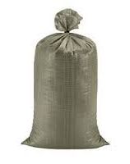
Don’t let Bags of sand weigh you down…
Imagine you are in a team meeting and one person is being really negative. In a group discuss:
Why might this person be acting like this?
What might get them involved or interested?
What could you do to deal with that person before, during and after the meeting?

Slide 23
Don’t let life take over
“Working more than 40 hours a week, doesn’t mean you’re doing your best…it just means you are working more than 40 hours a week”
Jason fried, basecamp

Slide 24
Take control…
1 Agree your non-negotiables
2 Take care of yourself
3 Do less to do more
4 Eat your frogs

Slide 25
Agree your non-negotiables…
On your own, write down all the things in your life that are most important to you being happy.
Now think about what you can do to succeed in these areas each week for example, going to the gym in the morning; having one day a week out of the office; being home for your child’s bedtime; eating healthily etc.
Now choose the most important one that you will stick by for one month.

Slide 26
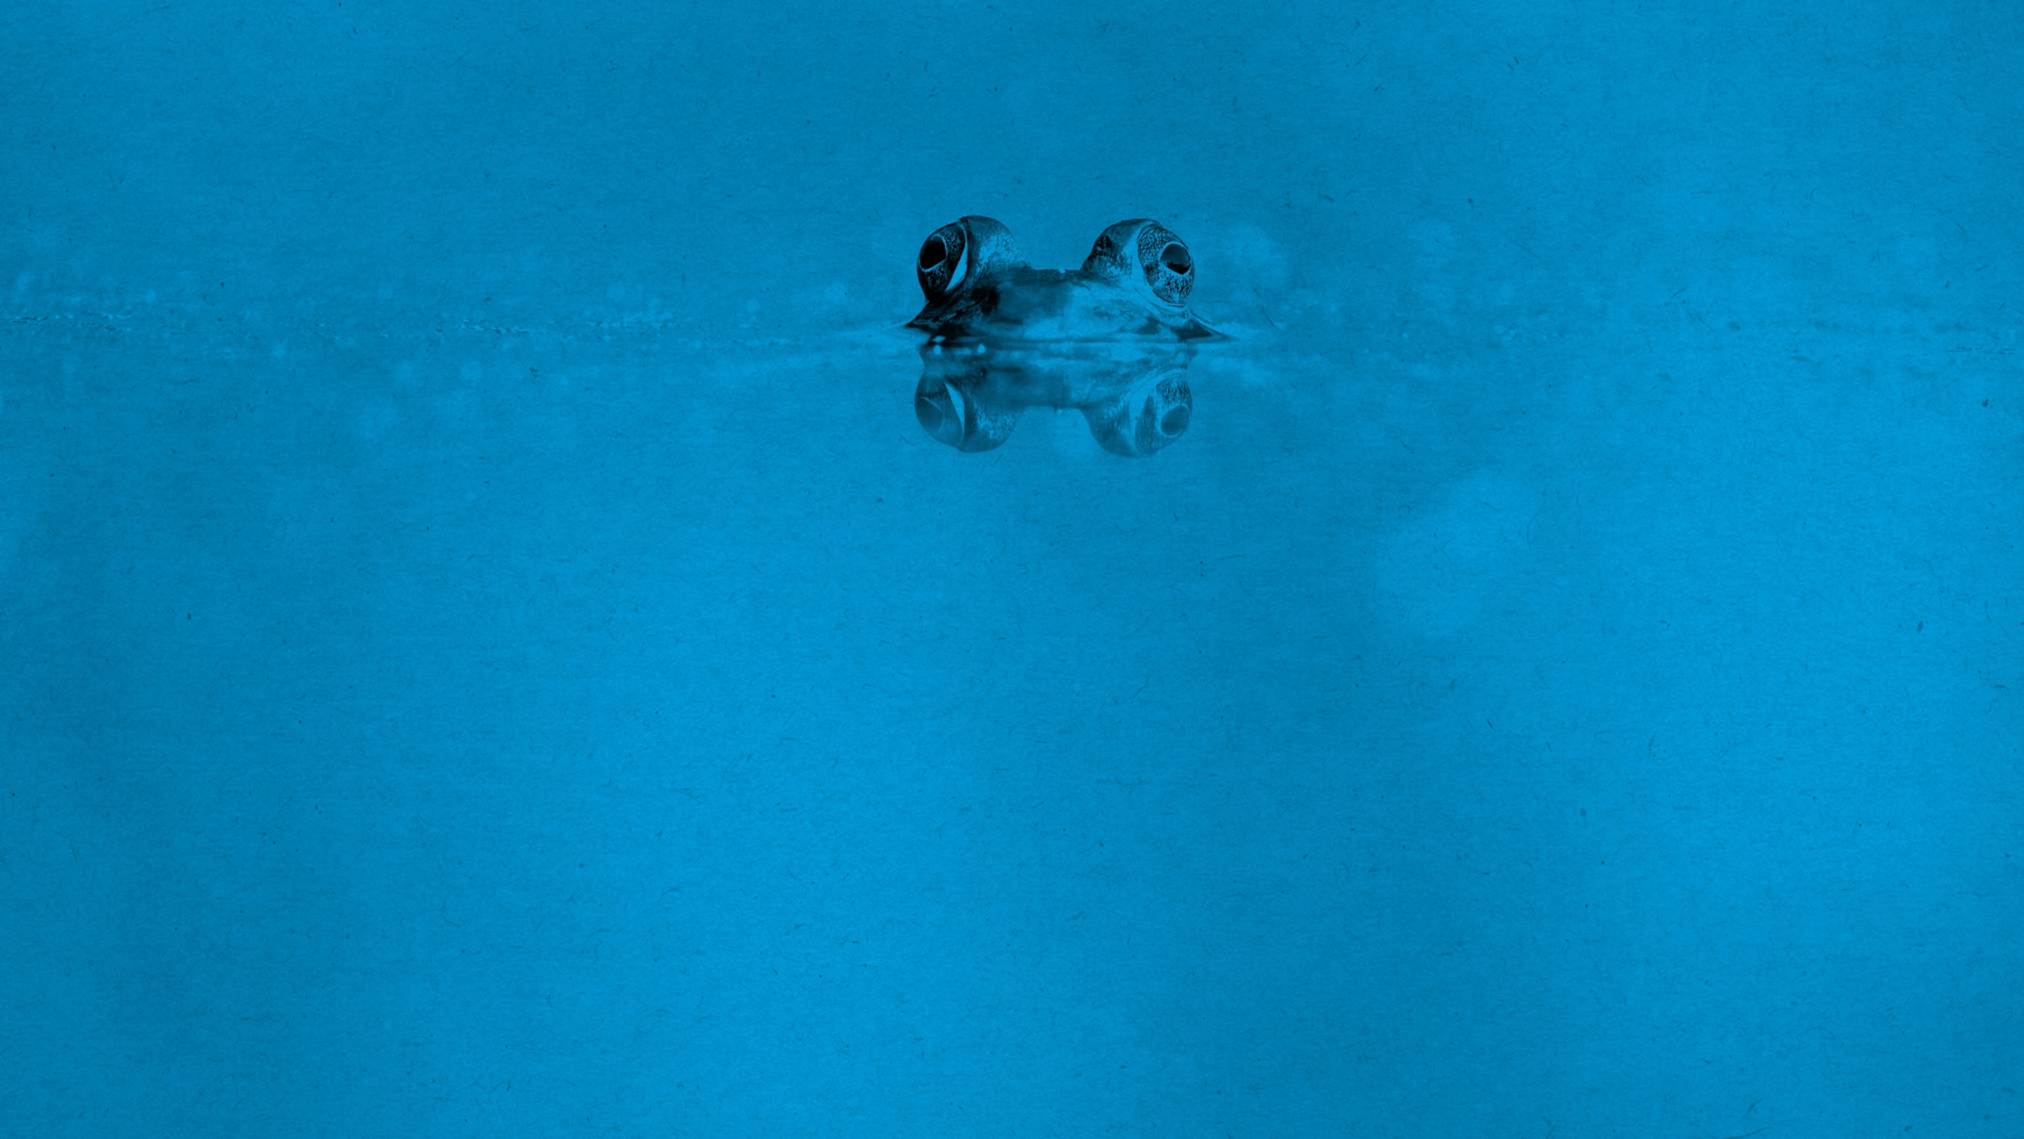
Eat your frogs…
When you get back to your desk, write down your “to do” list:
Next to each task, mark whether it’s something you dread doing but you know it’s important to do (a frog) or if it’s a task you love to work on (a prince).
Commit to completing one frog item first each day then reward yourself by doing something you love (or even a coffee and a biscuit!)

Slide 27
Your superhero potion… If you could create a potion to instantly transform yourself into your most brilliant self, what things would you put in there?
On your own write down:
Your superhero name
Your special power
The traits you use when performing at your best
Then, find a partner:
Agree together the ingredients needed for your potions

Slide 28
Are you being your brilliant self?
Be you - authenticity counts, what makes you brilliant?
Positivity is infectious – laugh, surprise & delight others, exceed expectations.
Fortune favors the brave – try something new and push your comfort zone.
Treat every day as a school day – be open to new thinking.
You can be creative – problem solve, be playful and just give it a try.
Be more Batman – be prepared for things not always going your way & don’t let set backs stop you. Remember what you have to be grateful for.
Breathe – look after yourself, find space, eat frogs.

Slide 29
Our deepest fear is not that we are inadequate. Our deepest fear is that we are powerful beyond measure. It is our light, not our darkness that most frightens us. We ask ourselves, Who am I to be brilliant, gorgeous, talented, fabulous? Actually, who are you not to be?..... Your playing small does not serve the world. There is nothing enlightened about shrinking so that other people won't feel insecure around you. We are all meant to shine, as children do… It's not just in some of us; it's in everyone. And as we let our own light shine, we unconsciously give other people permission to do the same. As we are liberated from our own fear, our presence automatically liberates others. NELSON MANDELA

Slide 30
A letter from my future brilliant self…
In your Journal, tell yourself how it feels to be your brilliant self in the future:
What does your brilliant future self look like? What is happening in your life? How do you feel? What are people saying to you?
Write down one thing that you would need to change to be your brilliant self in the future. What shifts do you need to make? What should you focus on to make it happen?
Note one person that you would like to surprise and delight. How can you make it happen?

Slide 31
Thank you!

Slide 32
BREAK Time
Notes:
Time for a break (10 mins)

