Slide 1
Leading by example
Develop your own unique and inspiring leadership style

Slide 2
Flow of the session
Inspiring Leaders develop inspiring visions
What makes a brilliant team
Smart Leaders differentiate
Brilliant Leaders deliver through others

Slide 3
YOU!
INTRODUCING

Slide 4
accelerator manifesto

Slide 5
INSPIRING LEADERS

Slide 6
HUMAN RIGHTS
MICHELLE OBAMA
PREVIOUS FIRST LADY
Notes:
.

Slide 7
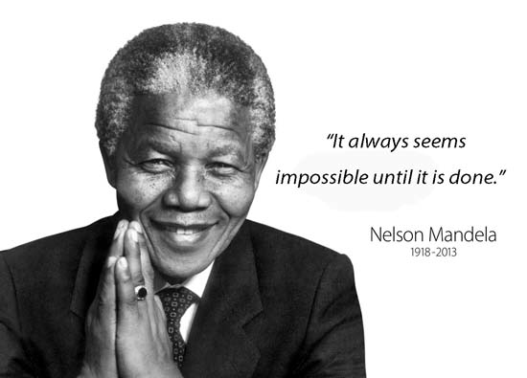
POLITICAL
NELSON MANDELLA
FIRST BLACK PRESIDENT OF SOUTH AFRICA

Slide 8
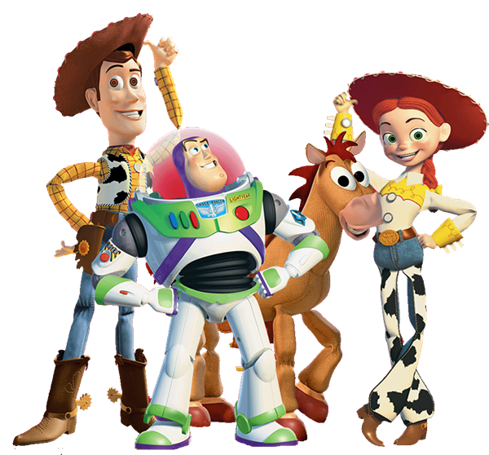
CREATIVE
ED CATMULL
FOUNDER AND PRESIDENT OF PIXAR ANIMATION AND DISNEY ANIMATION

Slide 9
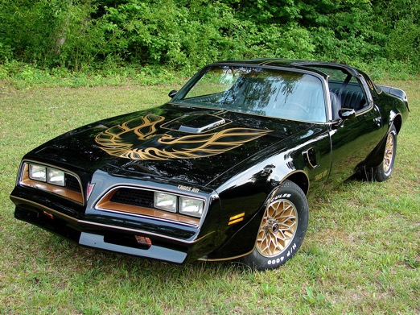
MANUFACTURING
MARY BARRA
CEO – GM

Slide 10
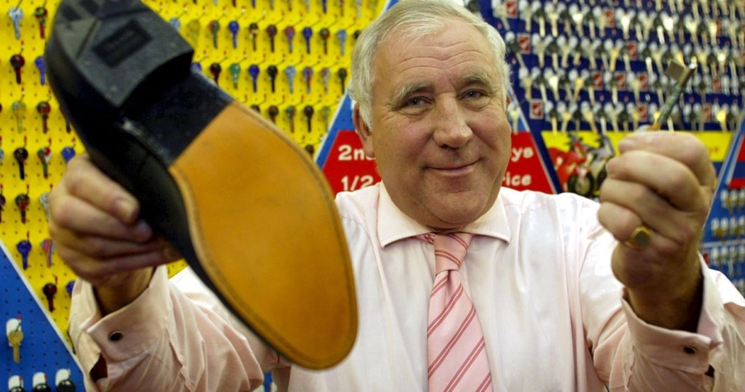
FOUNDER/OWNER
JOHN TIMPSON
CHAIR/FOUNDER/OWNER – TIMPSONS

Slide 11
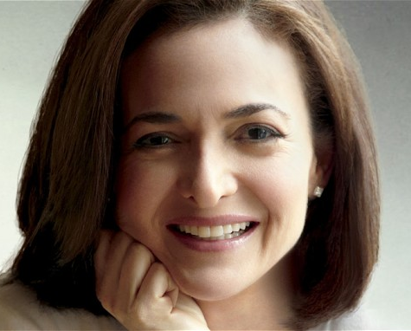
TECHNOLOGY
SHERYL SANDBERG
COO FACEBOOK
EX-GOOGLE
AUTHOR OF THE BOOK LEAN IN

Slide 12
RETAIL/ ENVIRONMENTALIST
ROSE MARCARIO
CEO – PATAGONIA

Slide 13
Inspirational Leaders
In pairs, discuss a leader who inspires you.
What are their values and which of their qualities do you admire?
What makes them such a great leader?
What could you learn from them?
Share back with the group

Slide 14
The Four Step Formula For Leadership Stardom
1
2
Know where you want to go
Dream big and know when you have achieved it
Know where you are now
Total honesty plus 100% ownership
3
4
Know what you have to do to get there
Develop options and make a decision
DO IT!
Relentless commitment
David Taylor

Slide 15
Developing your Leadership Vision
Award winners!
It is 2022 and you have won the “Leader of the Year” award.
You have been nominated by your team, colleagues and stakeholders. You are being interviewed by the World’s media.
In your journal complete the following questions and then share with a partner….
What was your motivational vision as a leader?
What qualities and behaviours did you show?
What challenges did you face?
How did you overcome the obstacles to be the leader you are today?

Slide 16
Why build brilliant teams?
What Impact does a successful and unsuccessful team member have on the…
ORGANISATION
TEAM
INDIVIDUAL
(on you as a leader)

Slide 17
Why Build Brilliant Teams?
A top performer adds over 65% more value than an average performer at the same salary.*
Top performers are 125% more productive in complex roles than average performers.*
80% of turnover is due to bad hiring decisions, says Harvard Business Review.
Statistics suggests the true cost of hiring a new recruit is 1/3 of total salary (which increases with seniority of the role).
Organisations with engaged, high performers are 4 x more profitable than organisations with unengaged, poor performers.*
* Gallup

Slide 18
What Makes A Brilliant Team?
TEAM PLAYERS
FUTURE POTENTIAL
TALENTED PLAYERS
DIVERSE SKILLS AND PERSPECTIVES

Slide 19
CREATE YOUR DREAM TEAM
WHAT SKILLS DO YOUR MIDFIELDERS NEED?
WHAT SKILLS DO YOUR DEFENDERS NEED?
WHAT SKILLS DO YOUR STRIKERS NEED?
EXECUTIONAL, PROBLEM SOLVING SKILLS THAT AVOID ISSUES OCCURRING
RELATIONSHIP ,COMMUNICATION AND ENGAGEMENT SKILLS
THAT CONNECT PEOPLE
BIG PICTURE, PROACTIVE SKILLS THAT CREATE OPPORTUNITIES

Slide 20
BRILILANT LEADERS DIFFERENTIATE…
Write on a post-it note your name.
In response to each question stick your Post-it note up on the wall whether you…
LOVE IT OR HATE IT?

Slide 21
BRILLIANT LEADERS DIFFERENTIATE…
YOU ACHIEVE GREAT RESULTS. YOU ARE GIVEN A CROWN AND SASH TO WEAR ALL DAY.
LOVE IT OR HATE IT?
YOU ARE GIVEN RESPONSIBILITY FOR AN ADMINISTRATIVELY HEAVY PROJECT. YOU NEED TO REPORT ON ALL THE OPERATIONAL DETAILS AND HIGHLIGHTS ISSUES THAT MIGHT GO WRONG.
LOVE IT OR HATE IT?
YOU ARE ASKED TO WRITE AN EMAIL TO YOUR BOSS EXPLAINING WHY A PROJECT YOU ARE WORKING ON IS NOT GOING AS WELL AS EXPECTED.
LOVE IT OR HATE IT?
YOU ARE ASKED TO GIVE A PRESENTATION TO THE BOARD IN ONE HOUR WITH NO EARLIER NOTICE.
LOVE IT OR HATE IT?

Slide 22
Brilliant Leaders Deliver Through Others
Congratulations!
You have done such a great job writing the plan you have been seconded to the government.
How will you make sure your plan is delivered in your absence?
Congratulations!
You been seconded to lead a ‘Be the Best’ project team. What are your three priorities for the next 12 months?

Slide 23
Brilliant Leaders Deliver Through Others
In your Journal, answer the following questions about a piece of work or project that you own…
Does this work need to be delivered by me?
Who else could deliver it instead of me?
What obstacles might get in the way of handing it over?
When can I hand it over?

Slide 24
Create a Movement

Slide 25
A letter to my future self…
How would I like my team to describe me as a leader?
I commit to understanding what my team love and hate by…
I commit by ---------- (date) to hand over work to ----------

Slide 26
Thank you!

Slide 27
“Watch your thoughts; they become words Watch your words; they become actions Watch your actions; they become habit Watch your habits; they become character Watch your character; it becomes your destiny” Lao Tzu

Slide 28
BREAK Time
Notes:
Time for a break (10 mins)

